Slide 1
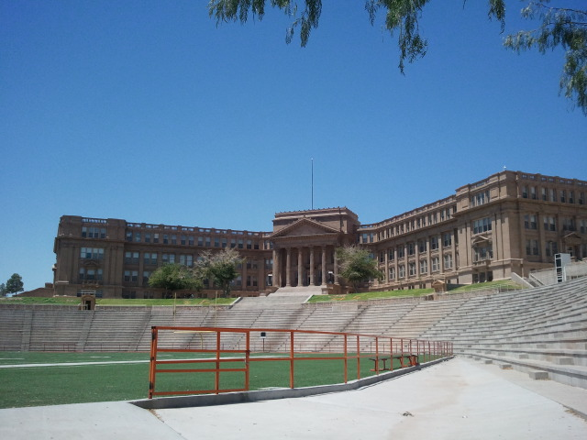
Let’s Talk College C O L L E G E P L A N N I N G

Slide 2
Am I Really Applying to College?
Important Tests
AP/Dual Credit/College Planning
Financial Aid & Scholarships
Questions ??

Slide 3
Announcements
PSAT & SAT – October 16th
(Regular Schedule)
TACRAO – October 22nd 1pm – 3pm
Mini FAFSA day:
Wed. Nov.20th from 1-5p.m. at the Go Center: Bring your FSA ID
Income tax 2018

Slide 4
College Already?

Slide 5
Why AP?
Why DC?
Why OnRamps?
ephsap.weebly.com
Research
Passing 1 AP exam – earn college degree in 5 years or less
Low income students - by passing 1 AP exam they are 32% more likely to graduate from college than non-AP peers.
Skills
Discipline
organization
time management
working through difficulties
test taking skills
opportunity to expand exposure
focus on growth and learning – Journey vs. Outcome
“Grit”

Slide 6
A - CTE STEM Cluster (4 credits)
Arts and Humanities
Public Service
Business & Industry
Multidisciplinary
E - Computer Science Combo
B - Core Concentration
Robotics CCTE Program
STEM
C - Advanced (4 advance core)
Engineering/Design CCTE Program
Health Science CCTE Program
Prin Engineering
Robotics
Comp Sci. OnRamps UT Austin
AP Comp. Sci. A
C - Math (5 credits)
Algebra 1
Algebra II
Adv. Math
Geometry
D - Science (5 credits)
*Biology
*Physics/ AP Physics/ Prin of Tech
Adv. Science
*Chemistry
Combination of Other
4x4 core subjects
AP courses
DC courses
A - Social Studies (5 credits)
* W Geography
* W History / AP W Hist
* US History / AP US Hist
* US Government / AP US GOV
* Economics /AP Macro Eco
AP European History
AP Human Geo
Psychology / AP Psychology
Sociology
SS Special Topics
American Cultural Studies
B - Languages other than English (4 levels)
Spanish 1 - 4
French 1 - 4
C - Languages other than English (2 and 2)
Spanish 1 - 2
French 1 - 2
E - Fine Arts
Art 1-4
Band 1-4
Choir 1-4
Dance 1-4
Guitar 1-4
Orch 1-4
Theater 1-4
Tech Theater 1-4
F- English Language Arts
Creative Writing
Lit Genres
Health Science CCTE Program
Health Science @ EPHS
Law Enforce CCTE Program
Law Enforce @ EPHS
Education @ EPHS
B - Junior Reserve Officer Training
ROTC 1
ROTC 2
ROTC 3
ROTC 4
A - Career and Tech Education @ CCTE
Animation 3D CCTE Program
Automotive Tech CCTE Program
Architectural Design CCTE Program
Audio Video Prod CCTE Program
Automotive Tech CCTE Program
Automotive Tech Coll CCTE Program
Automotive Diesel CCTE Program
Computer Maintainc CCTE Program
Piping & Plumbing CCTE Program
Network& Security CCTE Program
Construction Tech CCTE Program
Cosmetology CCTE Program
Culinary Arts CCTE Program
Electrical Tech CCTE Program
Fashion Design CCTE Program
Graphic Design CCTE Program
Metal Trades CCTE Program
Mobile App Dev CCTE Program
B - English (4 credits)
Debate I-3
Journalism 1-3
Newspaper1-3
Broadcast Journalism 1-3
Public Speaking
Yearbook 1-3
Add'l English elective
C - Technology Applications
Computer Science
Robotics
AP Computer Science
Digital Design Media
Web Design
Game Dev CCTE Program
D -Business Combination
Combo of A-C
A - Workforce/Post-secondary
A - Career and Technology Ed
Enlgish 4/ AP English Lit
Comm Apps
Independent Study
4 year of English
4 year of math
4 year of science
4 year of social studies
4x4 core subjects with:
Pre/AP courses
(4 credits)
Adv. Math
Adv. Science
D - Science -T-STEM Engineering ( 5 credits)
D - Science -T-STEM Biochemical (5 credits)
D - Science -T-STEM Environmental (5 credits)
2 year of FA x 2 year of FA

Slide 7
What does AP mean? PAP? Dual Credit? OnRamps?
(PAP) Pre Advanced Placement-Supports students who are interested in taking advanced courses
(AP) – Advanced Placement
Follows standards set by College Board
SAT/ PSAT/ AP falls under College Board
College credit may earned by passing AP exam with a 3,4,or 5
2 major premises set by College Board
Expectation-students can perform well at rigorous academic levels
Opportunity to engage in a higher level of learning and critical thinking.
(DC) Dual Credit-
College Courses at EPHS through El Paso Community College
Grade posts to college and high school transcript
OnRamps- University of Texas at Austin Courses at EPHS
Provides students with opportunity to take UT courses structured by a UT professor with support from EPHS Students
Students can choose to take the College credit.

Slide 8
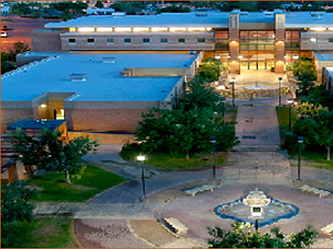
Dual Credit Partnership with El Paso Community College
1. Apply Texas-El Paso Community College
2. Pre-Assessment Module (PAM)
3. TSI Placement Test
Math-350+
Reading-340+
Writing-4+
EA form
(early admission)

Slide 9
El Paso High School Dual Language Magnet
Nationally recognized program
Classes taught 50% in Spanish and 50% in English
Program is skill specific, not career specific
Translation class only offered at EPHS
Earn UMC medical interpretation certificate
Earn up to 32 college credits
Earn Multiple HB 5 Endorsements
No. 1 skill set sought in the medical and pharmaceutical industries
Notes:
Insert New DL Logo- See Ceci P

Slide 10
T- STEM Academy
EL PASO HIGH SCHOOL
MISSION STATEMENT:
“…To provide a forward thinking and rigorously technology-based curriculum that fosters creative and critical thinking in the areas of science, technology, engineering and math so as to best prepare El Paso High School students for their future...”
Notes:
Insert new STEM Logo-See Ceci P

Slide 11
Magnet programS Expectations Dual Language T-STEM AP Capstone
12 DL Courses
Foreign Language
Rigor: PAP, AP, DC, DE
80% Overall GPA
Pathway Selection
T-STEM Electives
PAP, DC, DE Rigor
2+ Summer Bridge Programs
Mentor Program
AP Research
AP Seminar
4 add’l AP Courses
4 AP Scores, 3 or higher
*STEM Classes can be On-level Courses

Slide 12
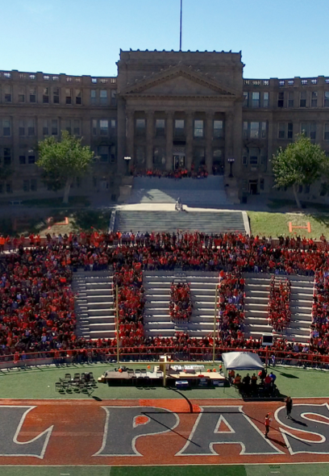
2 - Year upper level program
Offered only at EPHS
Can be combined with Dual Language Magnet or T-STEM Academy
Earn an AP C
Earn an AP Capstone Diploma

Slide 13
Advanced Classes offered at EPHS
Math Alg 2 OnRamps Pre-Calc. DC Pre-Calc. OnRamps AP Cal. AB AP Cal BC AP Statistics AP Computer Science OnRamps Computer Science | English AP Eng. Lang. AP Eng. Lit English 3 On Ramps AP Seminar AP Research AP English 3 AP English 4 | Social Studies AP Human Geo. AP World History AP US History DC US History AP Government AP Economics AP Psychology | Science AP Biology OnRampsChemistry OnRamps Physics 1 AP Physics 2 AP Physics C AP Envir. Science OnRamps Geology | Other AP Spanish Language AP Spanish Literature AP Art DC Communication

Slide 14
IMPORTANT STANDARDIZED TESTING FOR COLLEGE

Slide 15
Prepare for Important Tests
EOC exams - Graduation Requirement
* Take advantage of teacher assistance and before or after school tutoring.
* Algebra 1, Biology, English 1, English 2, and US History
PSAT
9th, 10th and 11th Grade Year
* National Merit Recognition Program
* National Hispanic Recognition Program
* National Achievement Scholarship Program
ACT and SAT:
* Should take after Algebra 2, or Spring of Junior Year, which ever comes first.
* Take each one once; highest score take again by the end of Junior year.
* Counts for College Admissions and Scholarships.

Slide 16
What Do Colleges Look For?
HOW TO PREPARE FOR ADMISSIONS

Slide 17
Top Ten Strengths & Experiences
A rigorous high school curriculum with advanced academics.
Explain why you took the classes you did.
Solid scores on
SAT / ACT
Grades that represent strong effort and an upward trend.
COMMUNITY VOLUNTEERING
Passionate involvement in a few activities.
Letters of recommendation that give evidence of differential. Letters of recommendation should tell WHO student is, not WHAT a student does.

Slide 18
Top Ten Strengths & Experiences (cont)
Demonstrated leadership activities; including non school activities
Demonstrated intellectual curiosity and vitality.
Demonstrated enthusiasm to attend often demonstrated by Decision Application
Early Action or Early Decision – typically higher rates of acceptance
A well-written essay-personal, not academic
-- demonstrates student’s unique personality, values and goals.
-- enlightens the reader and provides insight
-- global thinking
-- Essays to never write: doctor, lawyer, Disneyland, grandma

Slide 19
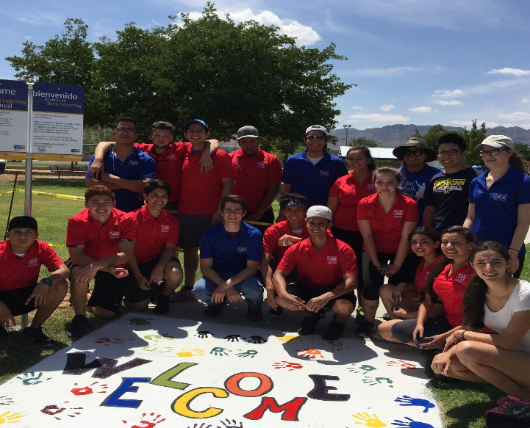
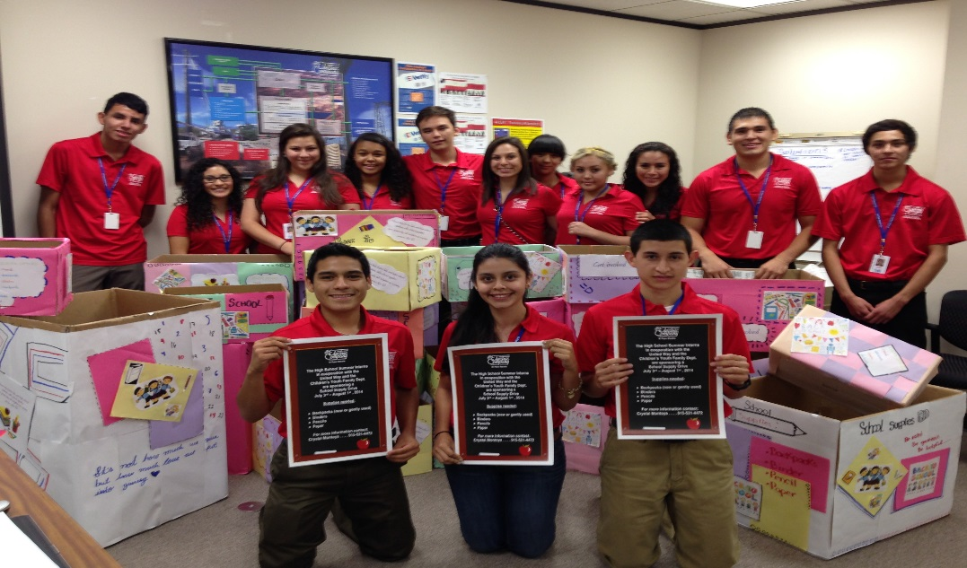
Summer Programs “Nothing is a waste of time if you use the experience wisely.” Auguste Rodin
Internships
El Paso Electric

Slide 20
Volunteer Opportunities
In the field of interest
Create SOMETHING, ANYTHING!
EXTRACURRICULAR ACTIVIES

Slide 21
Fly In Programs
Juniors and Seniors check your college of interest for such programs.
If they don’t have one, make plans with your family to visit such campuses and set up a time with them so that they may give you a tour.

Slide 22
College Admissions
How do I apply?

Slide 23
College Applications
Common Application
Ivy League, private colleges and out of state universities
Fill in personal information and letters of recommendation immediately
COMMON APPLICATION
Apply Texas
In State Public Schools
Independent Applications
NMSU
Put as many schools on one application type as possible!
Easier for you and easier for counselors and teachers
Keep all your usernames and passwords in one place!

Slide 24
Narrow College Choices
Begin
Begin discussion early.
Location, Size, On campus living, Financial Aid, Majors
Build
Build a mutual understanding of various expectations of student / parent
Start
Start conversation on realistic financial support / aid expectations
Attend
Attend College Visits by admission counselors at El Paso High during your Junior year and Senior Year.

Slide 25
Senior Year Survival
Work on essays and resume during the summer.
Keep calendar of application deadlines; use spreadsheet.
Review ephscollege.weebly.com and make a spreadsheet of scholarships for which you qualify and their deadlines.
If you have questions reach out to your counselor or Ms. Goldfarb, or call admissions office of university
EARLY BIRD GETS THE WORM!

Slide 26
Free & Reduced Lunch
WHY IT’S IMPORTANT

Slide 27
Free or Reduced Lunch
2 ACT Waivers ($102)
2 SAT Waivers ($104)
2 SAT Subject Test Waivers ($104)
8 College Application Waivers ($240)
4 ACT & 4 SAT Waivers
NCAA Clearinghouse Waiver ($65)
NAIA Clearinghouse Waiver ($70)
Apply for free and reduced lunch – it could save you $685. Application at https://elpaso.episd.org/welcome/index and click on the Eat Smart application.

Slide 28
Financial Aid
WHAT TO EXPECT
WHERE TO START

Slide 29
FAFSA Free Application for Federal Student Aid
http://www.fafsa.gov
Opens October 1 of Graduating Year--FAFSA Night –
A MUST DO for all seniors going to post-secondary education (trade school college or university).
It’s Free – don’t pay for it!
Students will get funding based on federal guidelines.
All Students should fill this out; many colleges and universities require it despite family income.

Slide 30
CSS Profile College Scholarship Service Profile
Private universities require this in addition to FAFSA
01
Used to determine financial aid
02
https://student.collegeboard.org/css-financial-aid-profile
03
(or google College Board CSS)
04
Notes:
Cannot see Box 3 text

Slide 31
Financial Aid/Scholarships – Where to Apply?
Federal Aid
FAFSA
Pell Grants
Work-Study
College
Distribute Funds for Federal & Foundation/
Private Aid
Community Scholarships
i.e. Community Foundation,
Rotary Club, EPHS Alumni, Athleta, etc.
National Scholarships
i.e. Gates, Dell, Coca Cola, etc.
Student

Slide 32
Financial Aid – When to apply?
Apply now, deadlines are coming quickly!
Start utilizing scholarship search services.
Statistics
50 applications might result in 1 scholarship
Apply to any and all scholarships for which you qualify
Scholarship Bulletins
Scholarship application information posted http://ephscollege.weebly.com/
Busiest Scholarship Time:
November – March of Senior Year
Seniors-1 hour a day working on scholarships
2 Hours a week during Junior Year

Slide 33
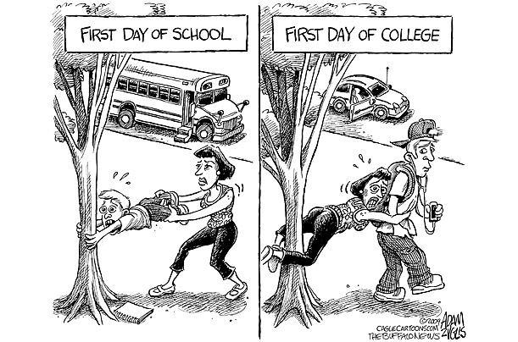

Slide 34
Class of 2019

Slide 35
Contacts
Mrs. Simpson, College Readiness Coordinator
casimpso@episd.org
Andrea Luevano, School Counselor A-D
rrodrig8@episd.org
Karla Tejeda, School Counselor E-K,
kmtejeda@episd.org
Cristina Rosales, School Counselor L-P,
crosale1@episd.org
Cecilia Espinosa, School Counselor Q-Z
ceaguil1@episd.org
Notes:
Update Counselors

Slide 36
Questions?
Check out our school website: https://elpaso.episd.org/
Check out our college readiness website: ephscollege.weebly.com

